Slide 1
University Model
By:
Mridul regmi
Manju sharma
Krishna DHONgade

Slide 2
Approach
To study the impact of course, faculty and department on student employment after graduation, three dashboards were built for each of these factors.
One dashboard was built for Alumini to show average stats of alumini after graduation
Using the analytics presented in the dashboards, the university administrators can assess the magnitude of the impact of each of the factors(faculty, course and department) on student employment, and make changes accordingly to optimize factors such as starting salary, promotion time, etc.
The dashboard can also be used by incoming students to decide course, department and faculty to improve their chances of getting a high paying job post graduation.

Slide 3
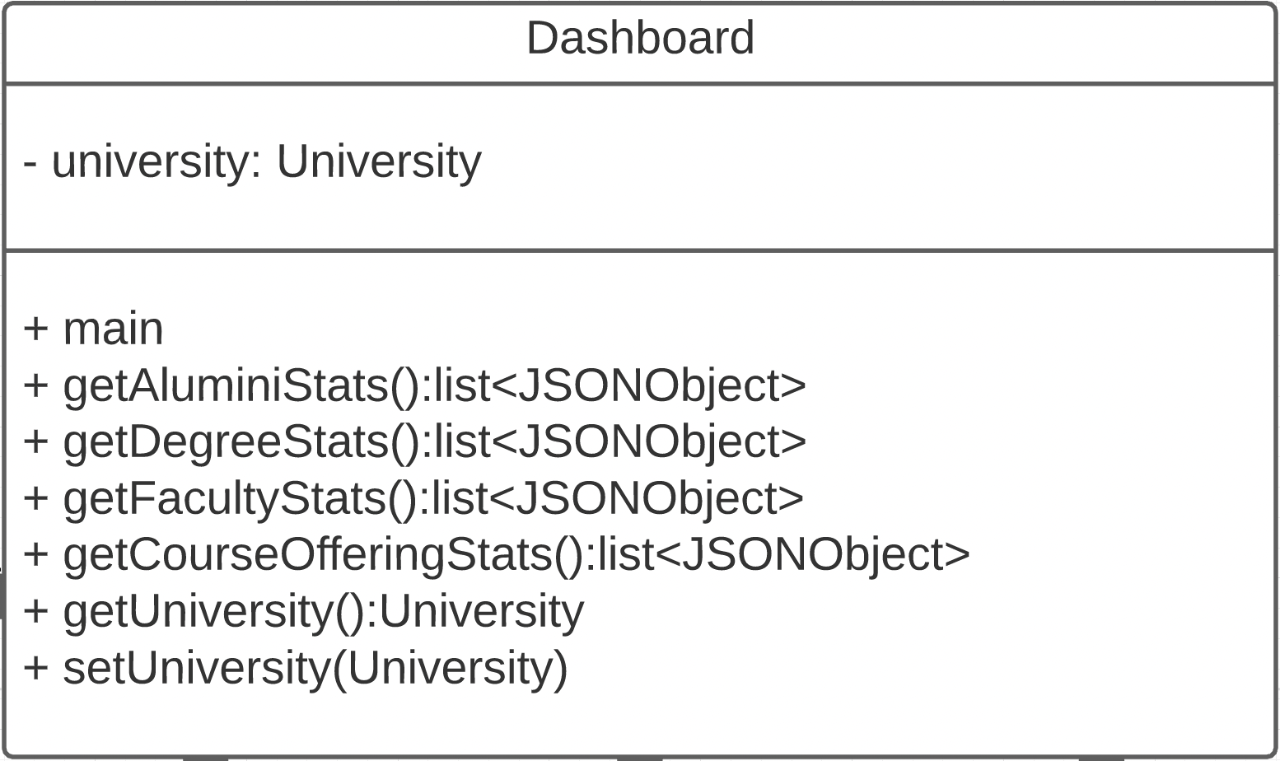
The Dashboard Class
Contains the main class
Fetches metrics and passes them to the frontend to be displayed in the dashboard for a particular university

Slide 4
Getting Alumini Stats
getAluminiStats() method:
Public class, returns a JSON object containing the post-graduation metrics for each alumini. The metrics include:
Starting salary
Average promotion time(if applicable)
Position
Ranking of employer(From sources such as Fortune)

Slide 5
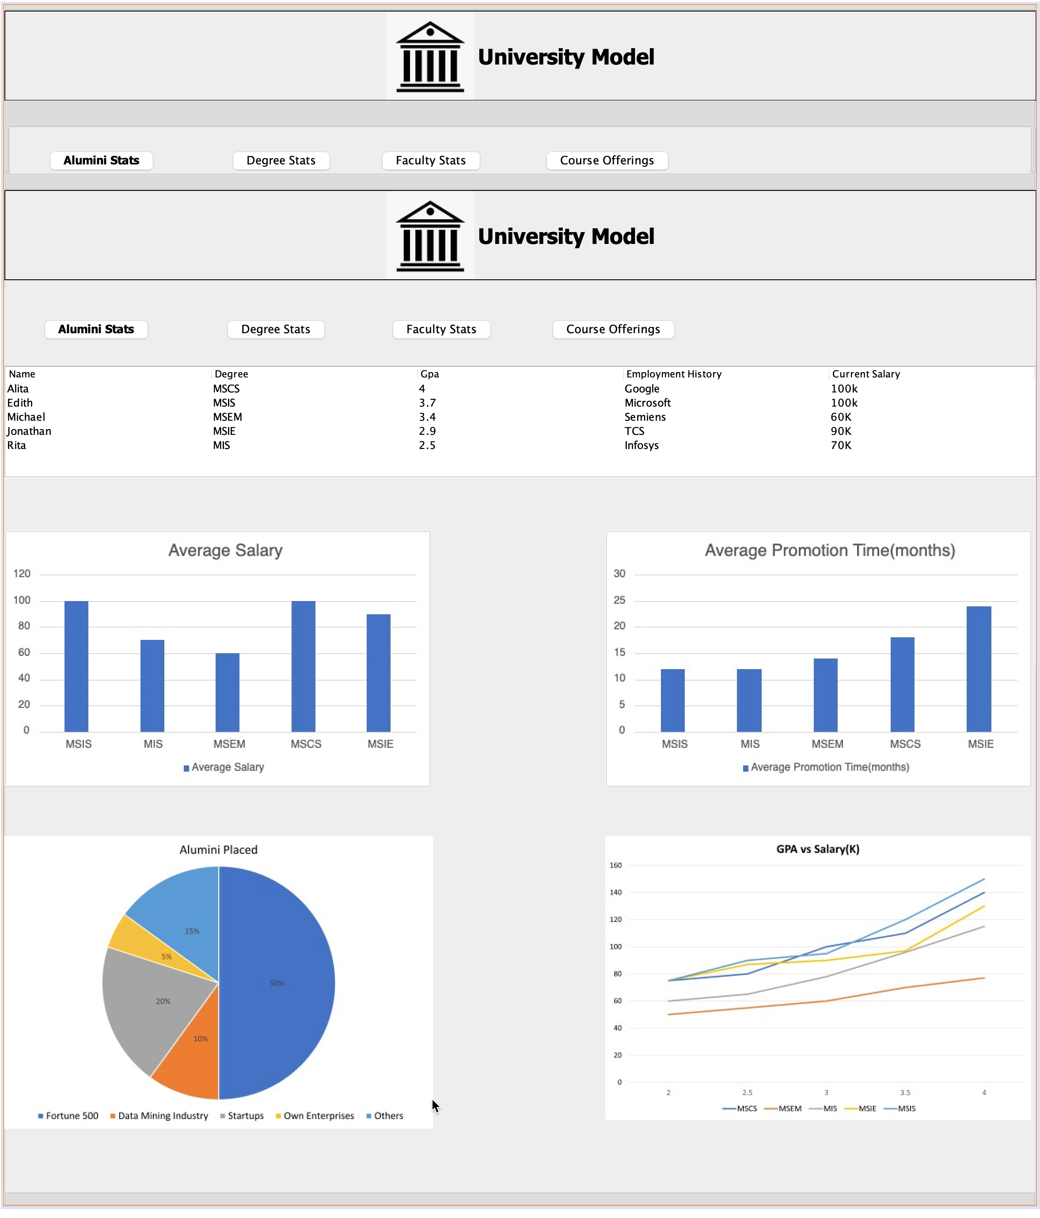

Slide 6
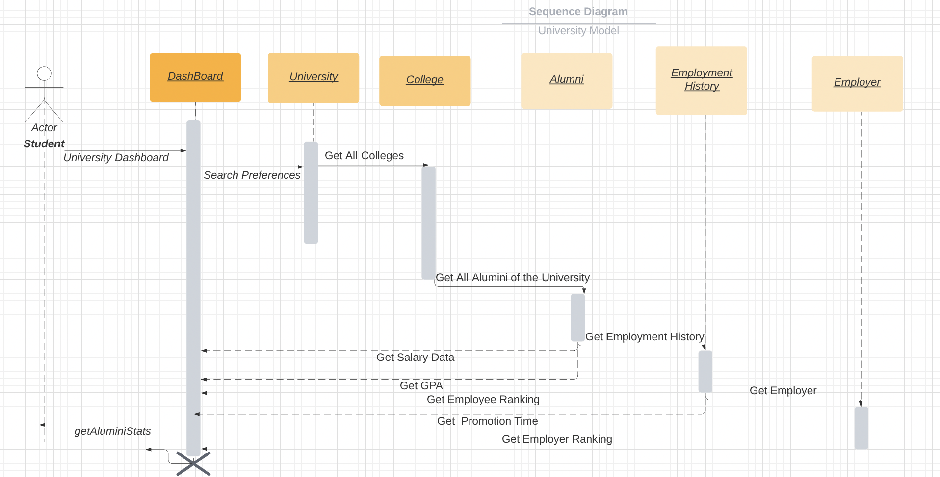
Getting Alumini Stats: Sequence Diagram

Slide 7
Getting Alumini Stats: Pseudo Code
public List<JSONObject> getAluminiStats(){
aluminiList= list of all students in the university;
ArrayList<JSONObject> aluminiJSONList = new ArrayList<>();
for(Alumini alumini: aluminiList){
JSONObject aluminiJSON = new JSONObject();
aluminiJSON.put("Current Salary", get average salary of alumini);
aluminiJSON.put("Average Promotion time", get average promotion time of alumini);
aluminiJSON.put("Position", get current employment position of the alumnini);
aluminiJSON.put("Employment History", employment history ranking of alumini);
aluminiJSON.put("GPA", get gpa of alumini)
aluminiJSONList.add(aluminiJSON);
}
return aluminiJSONList;
}

Slide 8
Getting Degree Stats
getDegreeStats() method:
Public class, returns a JSON object containing the post-graduation metrics for students belonging to the particular degree. The metrics include:
Average starting salary
Average promotion time(if applicable)
Average ranking of the companies the students are working for

Slide 9
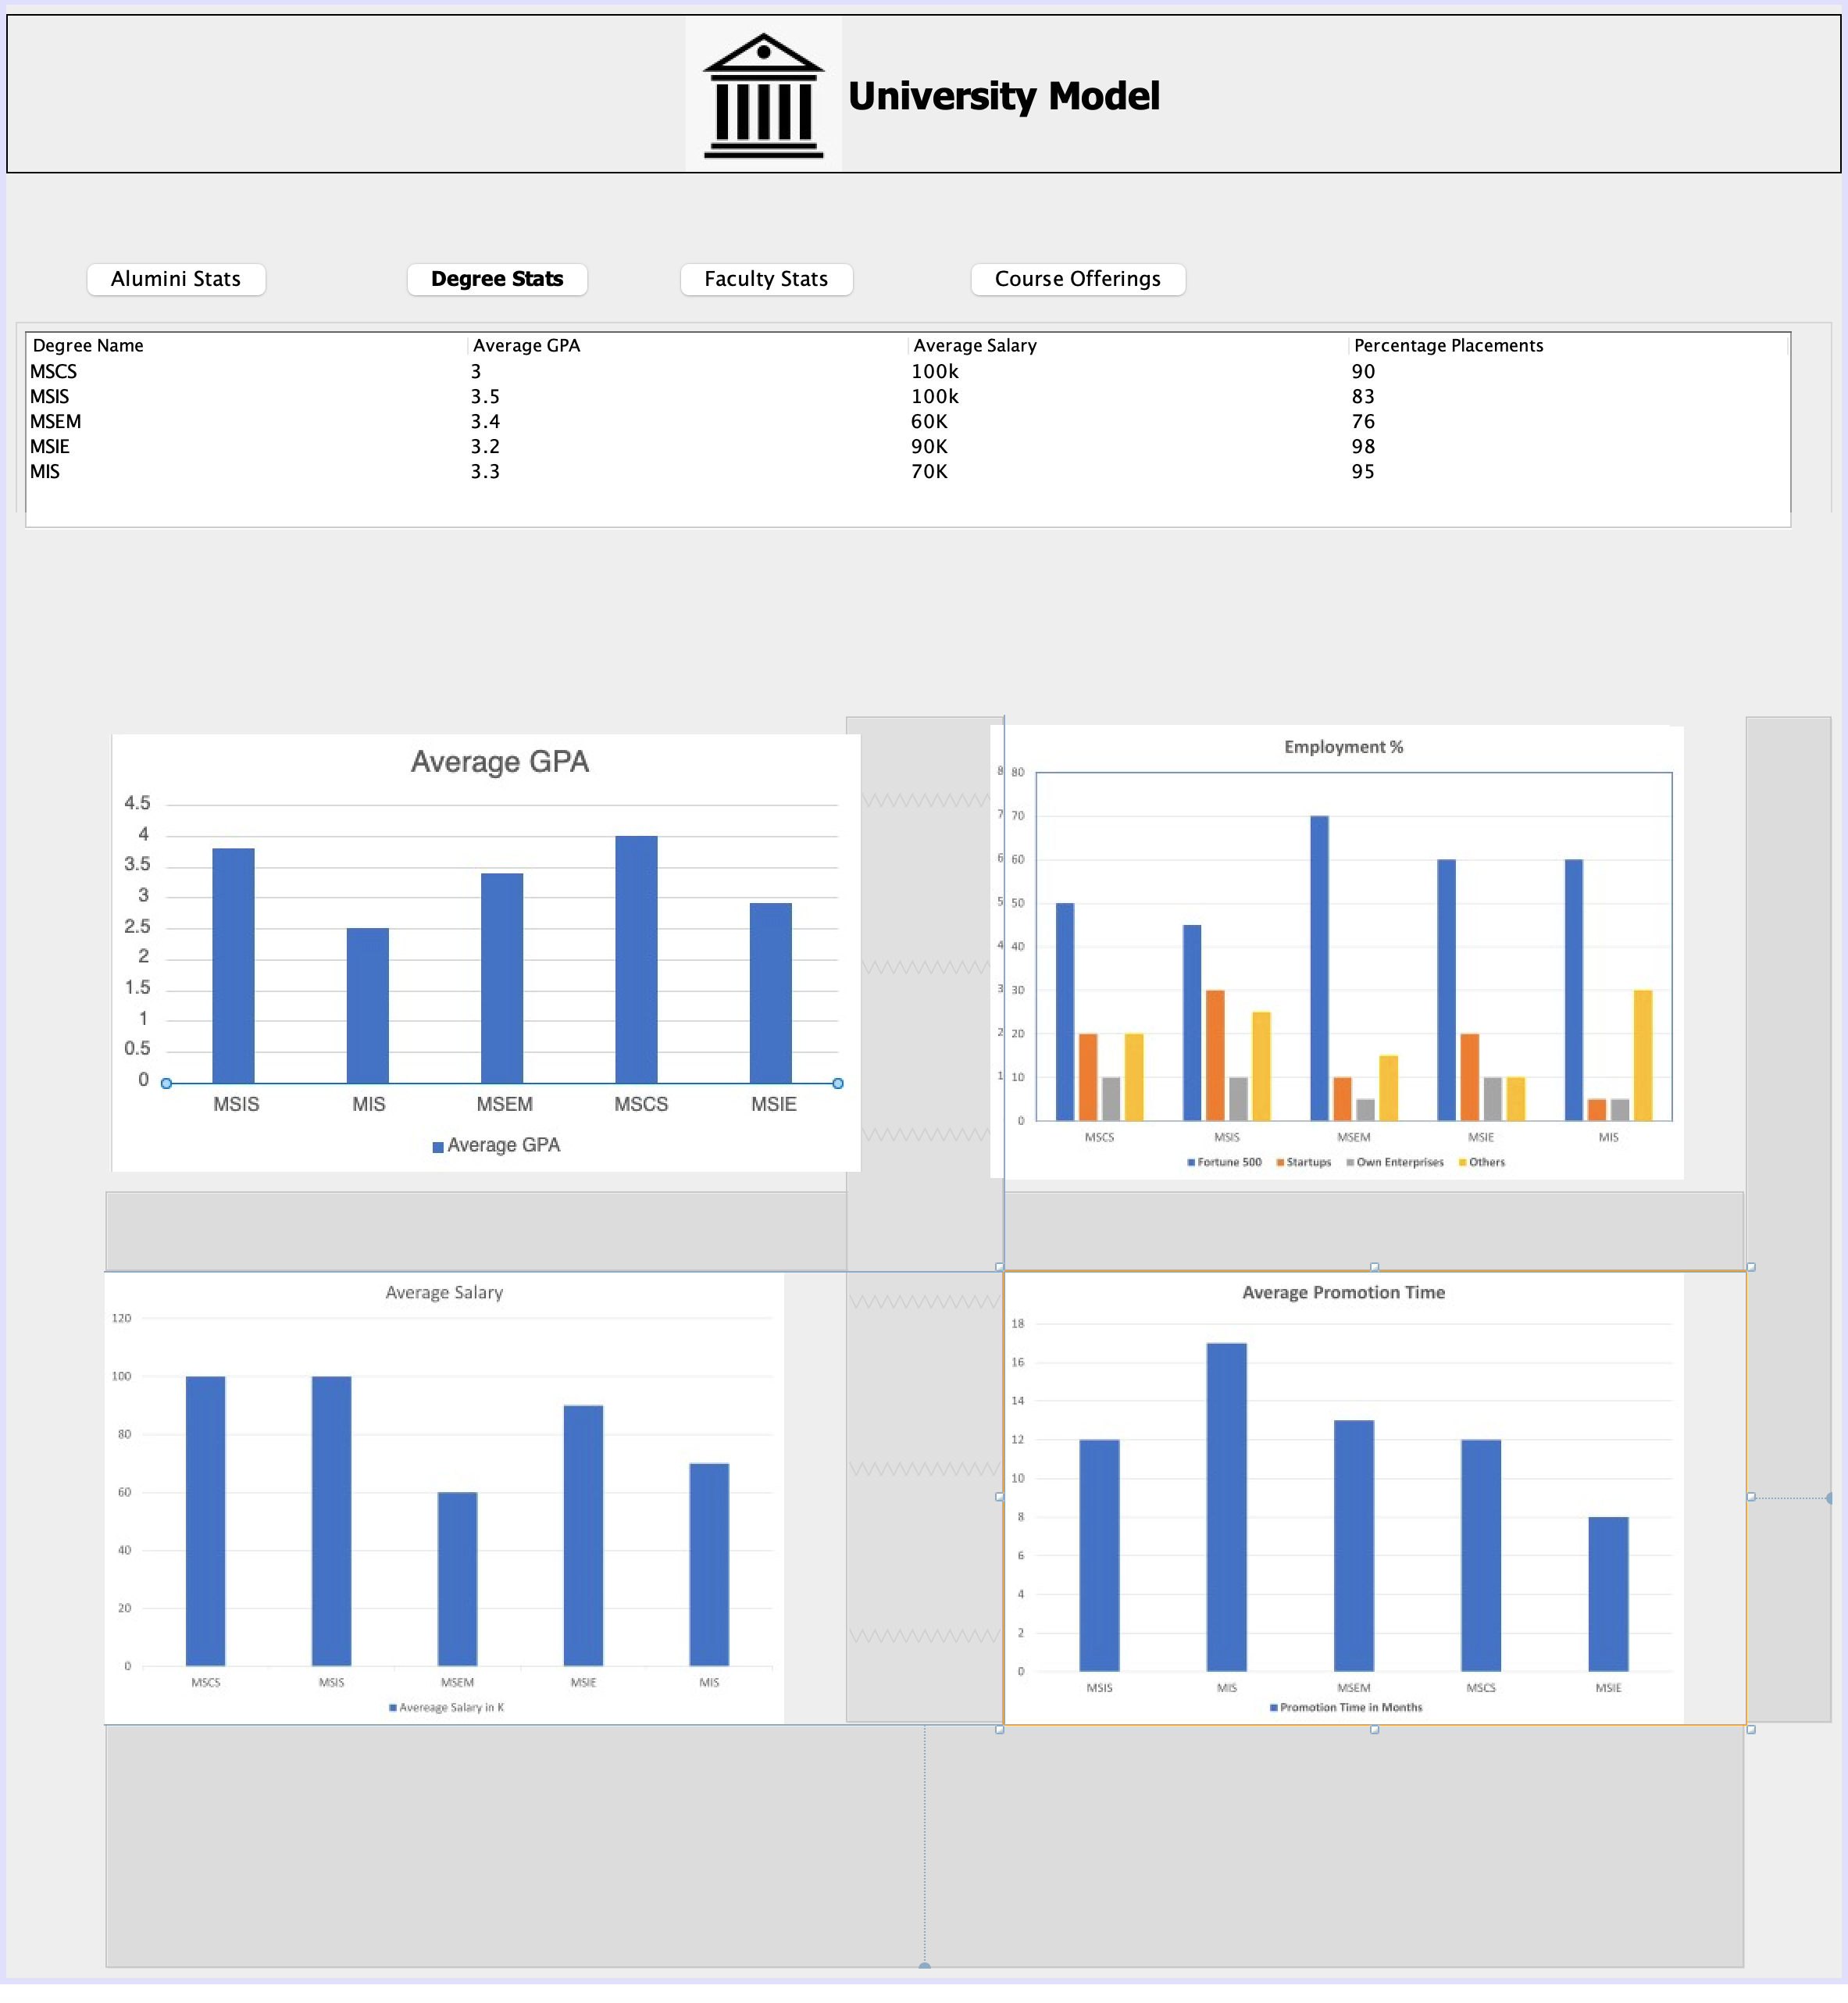

Slide 10
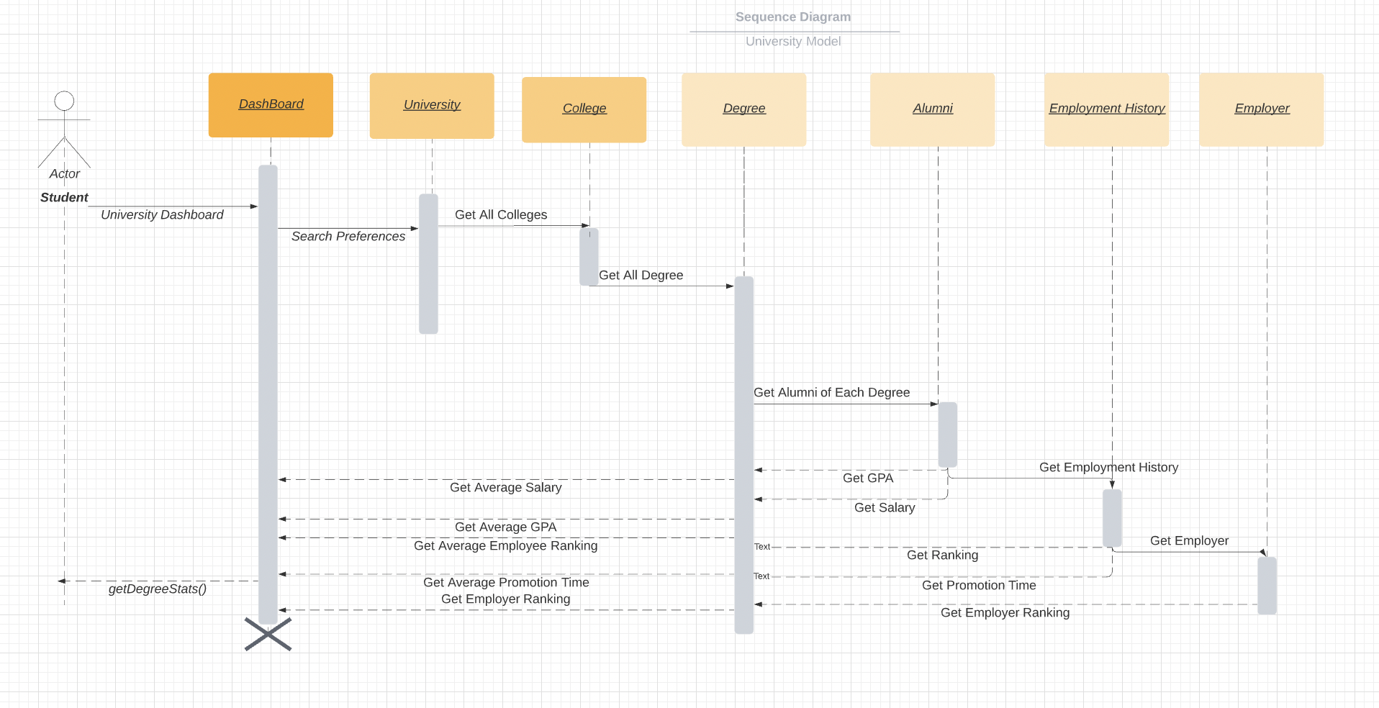
Getting Degree Stats: Sequence Diagram

Slide 11
Getting Degree Stats: Pseudo Code
public List<JSONObject> getDegreeStats(){
ArrayList<Degree> degreeList=list of all degrees offered in the university;
for(Degree degree: degreeList){
JSONObject degreeJSON = new JSONObject();
degreeJSON.put("Average Salary",average salary of students of this degree);
degreeJSON.put("Average Employee Rating",average employee rating);
degreeJSON.put("Average Employer Rating", average employer rating);
degreeJSON.put("Employed rate", percentage of students who got placed from college;)
degreeJSON.put("Average GPA",average GPA of students of this degree);
degreeJSONList.add(degreeJSON);
}
return degreeJSONList;
}

Slide 12
Getting Faculty Stats
getFacultyStats() method:
Public class, returns a JSON object containing the post-graduation metrics for students who were taught by a particular faculty. The metrics include:
Average starting salary
Average promotion time(if applicable)
Average ranking of the companies the students are working for

Slide 13
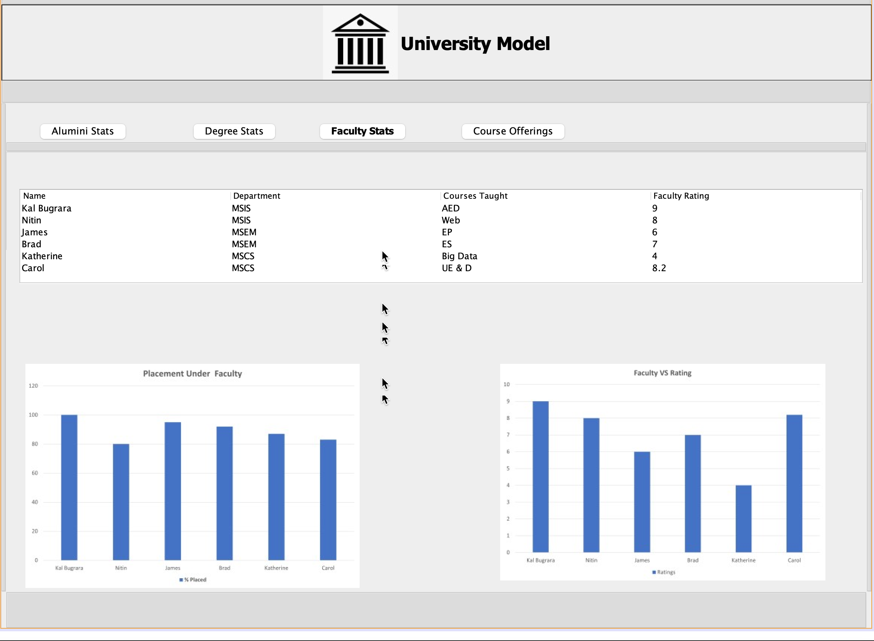

Slide 14
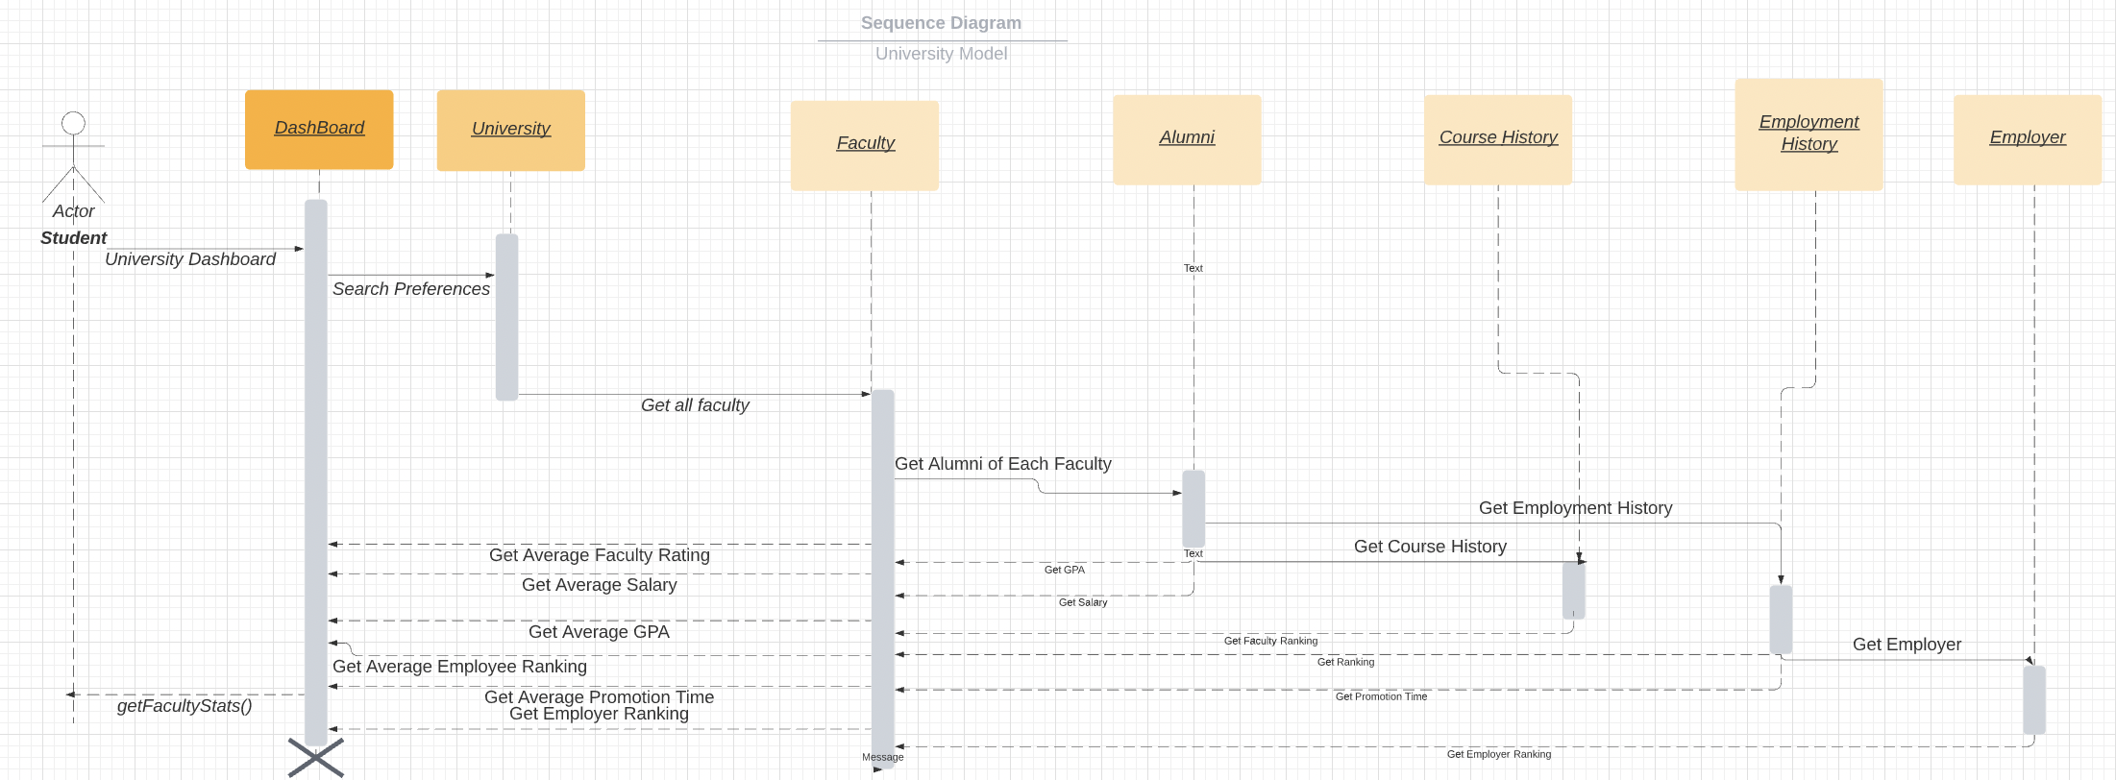
Getting Faculty Stats: Flow

Slide 15
Getting Faculty Stats: Pseudo Code
public List<JSONObject> getFacultyStats(){
ArrayList<JSONObject> facultyJSONList = List of all faculties within the unversity;
for(Faculty faculty: facultyList){
JSONObject facultyJSON = new JSONObject();
ArrayList<CourseOffering> coursesTaught = Courses taught by this particular faculty;
ArrayList<Alumini> aluminiForOfferings = aluminis who took the course offerings taught by the faculty;
facultyJSON.put("Average Salary",average salary of students of this faculty);
facultyJSON.put("Average Employee Rating",average employee rating of students of this faculty);
facultyJSON.put("Average Employer Rating", average employer rating);
facultyJSON.put("Employed rate", percentage of students of this faculty who got placed);
facultyJSON.put("Average GPA",average GPA of students of this faculty);
facultyJSONList.add(facultyJSON);
}
return facultyJSONList;
}

Slide 16
Getting Course Stats
getCourseOfferingStats():
Public class, returns a JSON object containing the post-graduation metrics for students who took a particular course offering. The metrics include:
Average GPA
Average starting salary
Average promotion time(if applicable)
Average ranking of the companies the students are working for

Slide 17
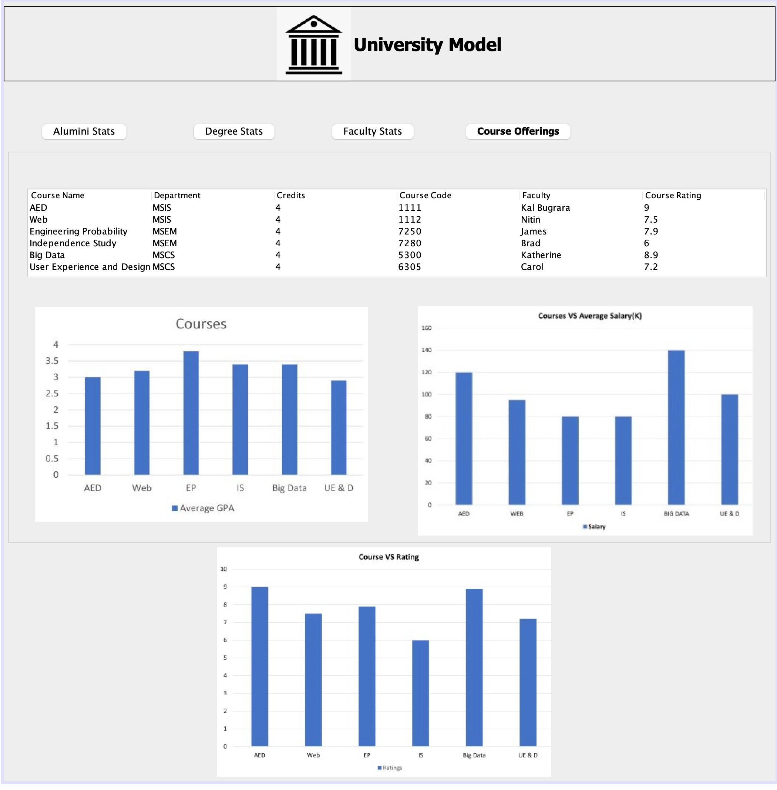

Slide 18
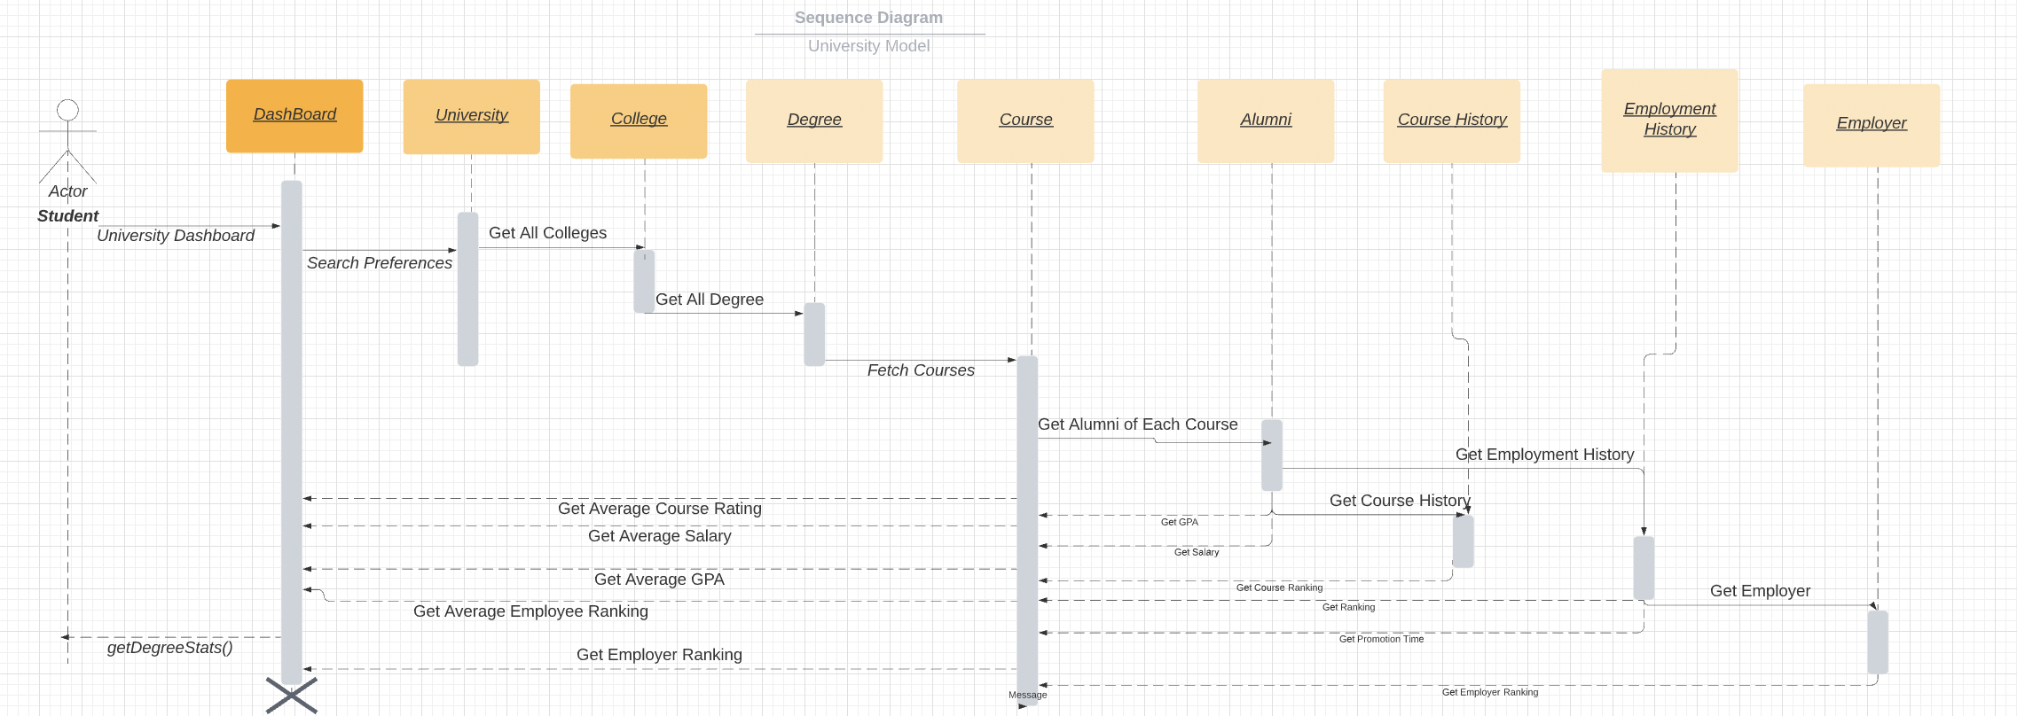
Getting Course Stats: Sequence Diagram

Slide 19
Getting Course Stats: Pseudo Code
public List<JSONObject> getFacultyStats(){
ArrayList<JSONObject> facultyJSONList = List of all faculties within the unversity;
for(Faculty faculty: facultyList){
JSONObject facultyJSON = new JSONObject();
ArrayList<CourseOffering> coursesTaught = Courses taught by this particular faculty;
ArrayList<Alumini> aluminiForOfferings = aluminis who took the course offerings taught by the faculty;
facultyJSON.put("Average Salary",average salary of students of this degree);
facultyJSON.put("Average Employee Rating",average employee rating);
facultyJSON.put("Average Employer Rating", average employer rating);
facultyJSON.put("Employed rate", percentage of students who got placed from college;)
facultyJSON.put("Average GPA",average GPA of students of this degree);
facultyJSONList.add(facultyJSON);
}
return facultyJSONList;
}

